Slide 1
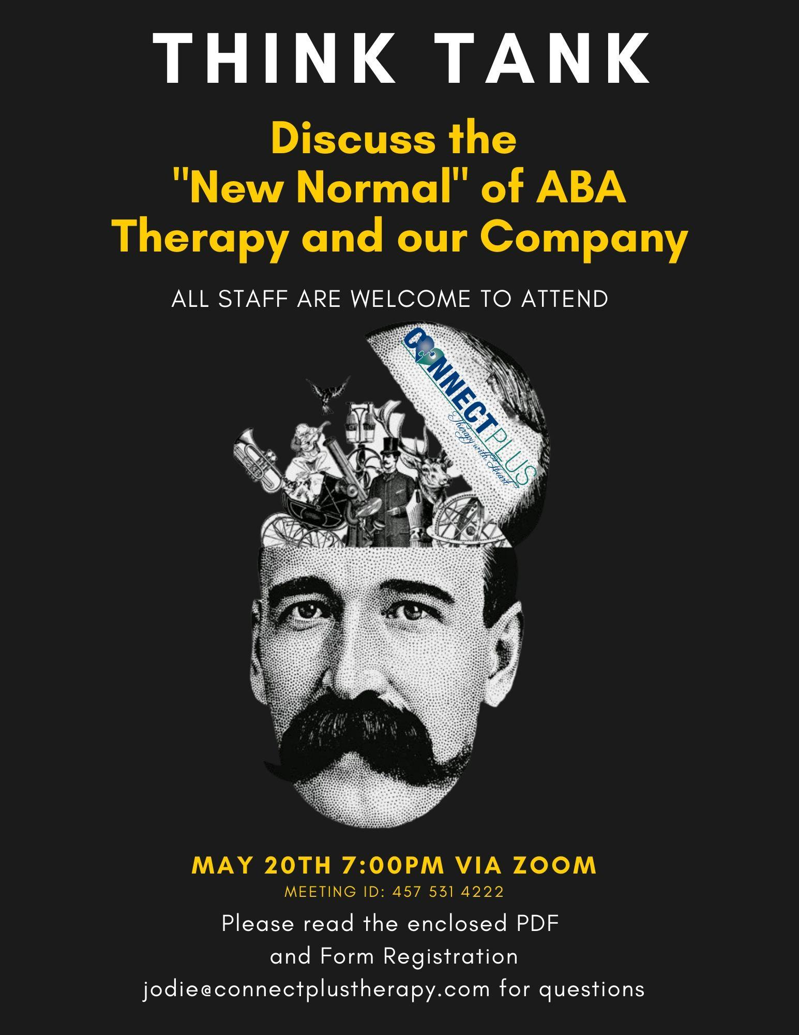
Register via Google Form here
https://forms.gle/YXys4NbMTGZYD7g17
Join Zoom Meeting
https://us02web.zoom.us/j/4575314222

Slide 2
CPT Think Tank
“The New Normal”
Jodie Littwin • 05.05.2020

Slide 3
What is a
Think Tank
&
Why Bother
: an institute, corporation, or group organized to study a particular subject (such as a policy issue or a scientific problem) and provide information, ideas, and advice
We are embarking on an age of unknown in the world of ABA Therapy. There are new ideas, venues and avenues for growth for CPT. Let’s get ahead of the curve!

Slide 4
Who should be involved?
: Anyone from the organization that wants to help shape ideas and policies for CPT. It is open to everyone; Admin, BCBAs and BTs on a voluntary basis

Slide 5
When
: There will be an initial teleconference to brainstorm and dicuss the topics.
Groups will be formed and will meet to discuss at a mutually convenient time.
Follow up meeting to present ideas about the individual topics

Slide 6
Topics you ask?
: Including but not limited to the following:
Telehealth
Ways to improve
Outreach (esp since schools closed)
New post-crisis operating standards
Restarting home services (to those that don’t currently have)
What will that look like?
Precautions?
Improving Communications (non F2F)
Admin to Staff
Staff to Families
Camp
Virtual?
At Home?
September
Transition back to School
Help equip districts/consultation basis

Slide 7
Other Random Thoughts from Jodie
:Providing our families with safety guarantees that restore trust
Safeguarding the health of employees
Reviving demand

